Slide 1
SEZNG , Integration of informal, MSMEs and Local Economic Development Rapport: la promotion de l'entreprenariat 4.0 et insertion des jeunes et femmes dans les chaînes de valeur et clusters à haut potentiel en Afrique Centrale.
Symposium for the successful Harmonization of frameworks for the development and operationalization of New Generation Special economic Zones
Présenté par Dr. Tumenta Kennedy
22 January 2025| Douala
UNECA Sub-Regional Office for Central Africa

Slide 2
Situation de la CEEAC vis-à-vis des 100 et 500 meilleure entreprise du monde et de l’Afrique
Selon le rapport « FORTUNE 500 » 2022, aucune entreprise de la CEEAC n’est classée parmi les 500 meilleurs entreprises au monde de même qu’en Afrique en général.
D’après le rapport du journal jeune Afrique sur le classement des 500 meilleur entreprise Africaine, seul l’entreprise « Sociedade Nacional de combustiveis de Angola » est classé parmi les 10 premier occupant la 7^{ième} place et on retrouve plus loin l’entreprise « KIBALI BOLD MINE » de la RDC occupant la 97^{ième} place. Comparativement aux entreprises comme « SONATRACH » de l’Algérie à la 1^{ière} place du classement et les autres pays d’Afrique.

Slide 3
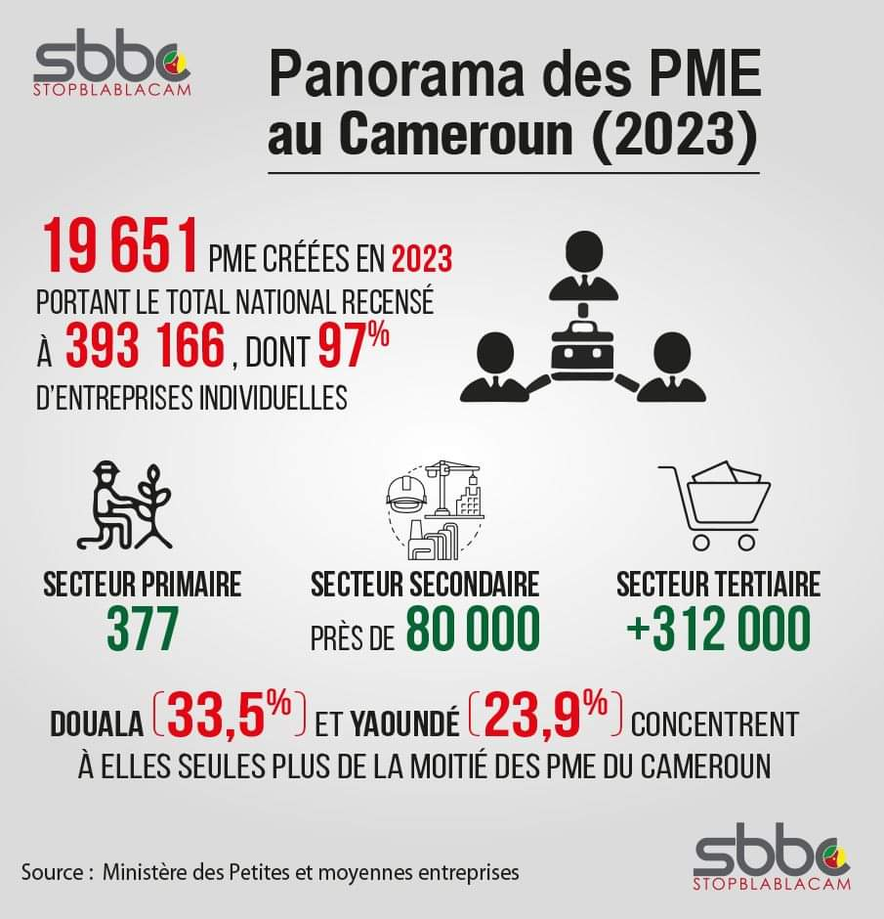
Notes:
Brief overview of the SME landscape in Cameroon:
Number of SMEs:
Approximately 370,000 registered SMEs.
Over 90% of businesses in Cameroon.
97 % Individual enterprises
Contribute to 60-70% of employment.
Key Sectors:
Agriculture & Agro-processing: 40% of SMEs; key products include cocoa, coffee, cassava.
Trade & Retail: 35% of SMEs; vital for local goods and services.
Manufacturing: 15% of SMEs; includes food processing and textiles.
Services: 10% of SMEs; encompasses transportation, hospitality, and ICT.
Average Employees:
Approximately 3-5 employees per SME.
Challenges:
Access to Finance: Only 10% of SMEs have access to bank loans.
Infrastructure Deficiencies: 50% of rural SMEs lack reliable electricity.
Market Competition: 70% of SMEs report challenges from larger firms and imports.
Skill Gaps: 40% of SMEs cite a shortage of adapted skilled labour.

Slide 4
Unlocking Hidden Potential within the Graduation Model
Upgrade Intensity
Evolutionary strategies for formalisation & adaptive investment (SEZ new Generation)
Familiarization
Introduction (Startup or Existence)
Growth
Maturity
Expansion
New Generation Special economic Zones ????
-------
Medium Size Entreprices (MEs)
Multinational Entreprises
Transnational Societies
Small Medium Size Entreprices (SSEs)
Very Small Size Entreprices (VSEs
NGO Association
Survival Enterprise
Social Model Business
GIC
CIG
Enterprise Owned
Cooperative
Test and Learners
Entrepreneurs
98.5% TPE/PE
1.3% ME
(Humanitarian preoccupations)
Social Responsibility of Enterprises
Social Responsibility of Enterprises
Microfinance , Micro-insurances
Indigeneous Entreprises
Time to upgrade
High degree of informal activities’
High degree of formal activities’
Notes:
reveals that in 2020, 330,543 business units were registered by its ministerial department.
98.5 are TPE (very small enterprises) and PE (small enterprises) and 1.3% are ME (medium-sized enterprises)", explains Minpmeesa.
Which represents "99.8% of the total business population in Cameroon", It is also a little over 100,000 SMEs created in four years, because in 2016, the country had 209,000.“
Localized Solutions: Financial institutions tailored to regional needs.
Community Engagement: Better understanding of local markets.
Tailored Financial Products: Microloans, flexible repayment options

Slide 5
Overview of the SME Landscape in Cameroon
Number of SMEs:
Approximately 393166 registered SMEs.
Over 90% of businesses in Cameroon.
Contribute to 60-70% of employment.
2020 (330543) , difference 62623
Key Sectors:
Agriculture & Agro-processing: 40% of SMEs; key products include cocoa, coffee, cassava.
Trade & Retail: 35% of SMEs; vital for local goods and services.
Manufacturing: 15% of SMEs; includes food processing and textiles.
Services: 10% of SMEs; encompasses transportation, hospitality, and ICT.
Average Employees:
Approximately 3-5 employees per SME.
Challenges:
Access to Finance: Only 10% of SMEs have access to bank loans.
Infrastructure Deficiencies: 50% of rural SMEs lack reliable electricity.
Market Competition: 70% of SMEs report challenges from larger firms and imports.
Skill Gaps: 40% of SMEs cite a shortage of adapted skilled labour.
Notes:
reveals that in 2020, 330,543 business units were registered by its ministerial department.
Which represents "99.8% of the total business population in Cameroon",It is also a little over 100,000 SMEs created in four years, because in 2016, the country had 209,000.“
2020 (330543) , 2023 (393166) difference 62623
98.5 are TPE (very small enterprises) and PE (small enterprises) and 1.3% are ME (medium-sized enterprises)", explains Minpmeesa.
He adds that "the predominance of VSEs and PEs is due to the fact thatthe economic fabric remains strongly dominated by individual companies, i.e. 62.8% of active production units against 11% of corporate companies (Sarl, SA and other legal forms)".SMEs contribute 70% in terms of employment in Cameroon and through their turnover, they contribute 34% to the national economy.
They also have "an average self-financing capacity of nearly 80% which allows them to meet working capital financing needs for current activity without having to resort to loans",Despite all this, Minpmeesa confesses that SMEs "still contribute little to national added value, i.e. only 12%, because they are found at 84% in the tertiary sector of small businesses and local activities, 15.6% in the secondary processing sector and only 0.2 in the primary sector".

Slide 6
Unlocking Hidden Potential within the Graduation Model
Upgrade Intensity
Evolutionary strategies for formalisation & adaptive investment (SEZ new Generation)
Familiarization
Introduction (Startup or Existence)
Growth
Maturity
Expansion
-------
Medium Size Entreprices (MEs)
Multinational Entreprises
Transnational Societies
Small Medium Size Entreprices (SSEs)
Very Small Size Entreprices (VSEs
NGO Association
Survival Enterprise
Social Model Business
GIC
CIG
Enterprise Owned
Cooperative
Test and Learners
Entrepreneurs
98.5% TPE/PE
1.3% ME
(Humanitarian preoccupations)
Social Responsibility of Enterprises
Social Responsibility of Enterprises
Microfinance , Micro-insurances
Indigeneous Entreprises
Time to upgrade
High degree of informal activities’
High degree of formal activities’
Capacity Building (skill), investment/fundings, infrastructure (T&Q), leadership, KPI, security, business climate regulation, governance mechanisms, information bank, networking (B2B, B2C, .), visibility, business engineering, social security, security networks ---
In order to improve the business environment dominated by the informal sector, it is imperative to implement an evolutionary strategy that will formalize the latter
Notes:
reveals that in 2020, 330,543 business units were registered by its ministerial department.
98.5 are TPE (very small enterprises) and PE (small enterprises) and 1.3% are ME (medium-sized enterprises)", explains Minpmeesa.
Which represents "99.8% of the total business population in Cameroon", It is also a little over 100,000 SMEs created in four years, because in 2016, the country had 209,000.“
Localized Solutions: Financial institutions tailored to regional needs.
Community Engagement: Better understanding of local markets.
Tailored Financial Products: Microloans, flexible repayment options

Slide 7









Proximity Support Ecosystem 4.0: Our approach to creative and integrative solutions SUB-REGIONAL INCUBATOR AND ACCELERATOR
Channels specific skills, abilities and upgrading services to enterprises at different stages of entrepreneurial activities; facilitates the evolution of mature enterprises: moving from a high level of informality to a more formal level.
This approach takes into consideration the specific local nature of entrepreneurship in the region which is predominantly informal or relatively in its nascent state.
Accelerating the growth of regional champions for continental and global competitiveness
Support champion companies at the sub-regional level
Incubate innovative projects to meet national demand
SME/
SMI
Group, structure and support small producers and informal businesses at the local level
Notes:
This will improve the competitiveness of Startups, VSEs, SMEs/SMIs in value chains enabling high potential and to strengthen the capacities of young people and women to equip them with employable skills via direct jobs or through entrepreneurship 4.0.

Slide 8
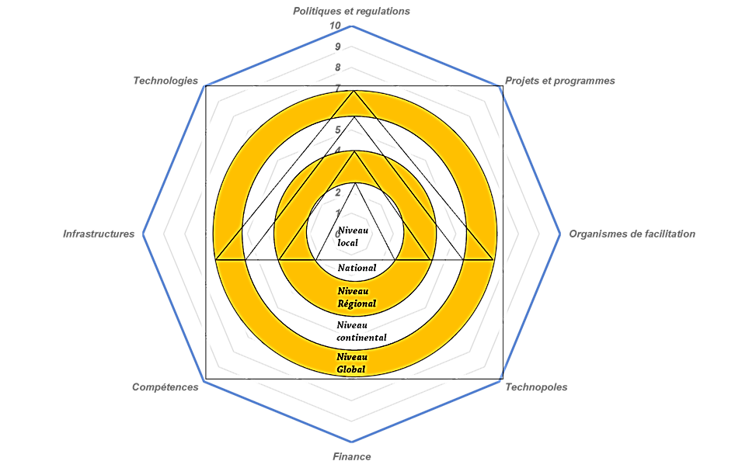
The Grading Process
The process will initially involve improving the business environment by building a solid, multi-dimensional ecosystem centered on people, processes and technology; then, based on 5 superimposed layers or layons: local, national, regional, continental and global.
Notes:
Localized Solutions: Financial institutions tailored to regional needs.
Community Engagement: Better understanding of local markets.
Tailored Financial Products: Microloans, flexible repayment options
The process will initially consist of improving the business environment by building a strong multi-dimensional ecosystem focused on people, processes and technology; then, sitting on 5 layers or overlapping layers: local, national, regional, continental and global layers.
Accelerate the growth of regional champions for continental and global competitiveness
Support champion companies at the sub-regional level
Incubate innovative projects to meet national demand
Group, structure and support small producers and informal businesses at the local level

Slide 9
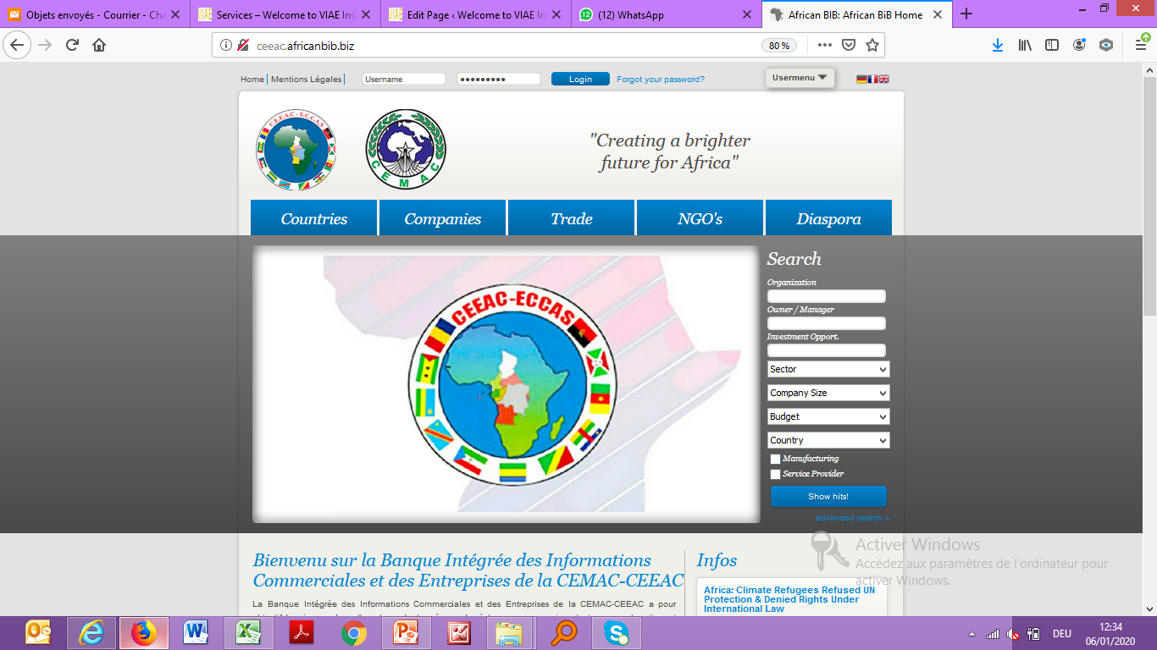
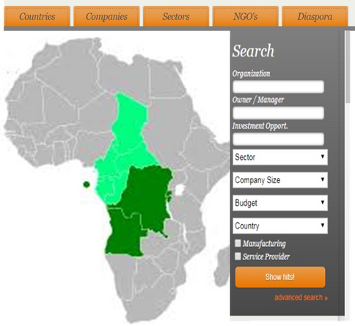

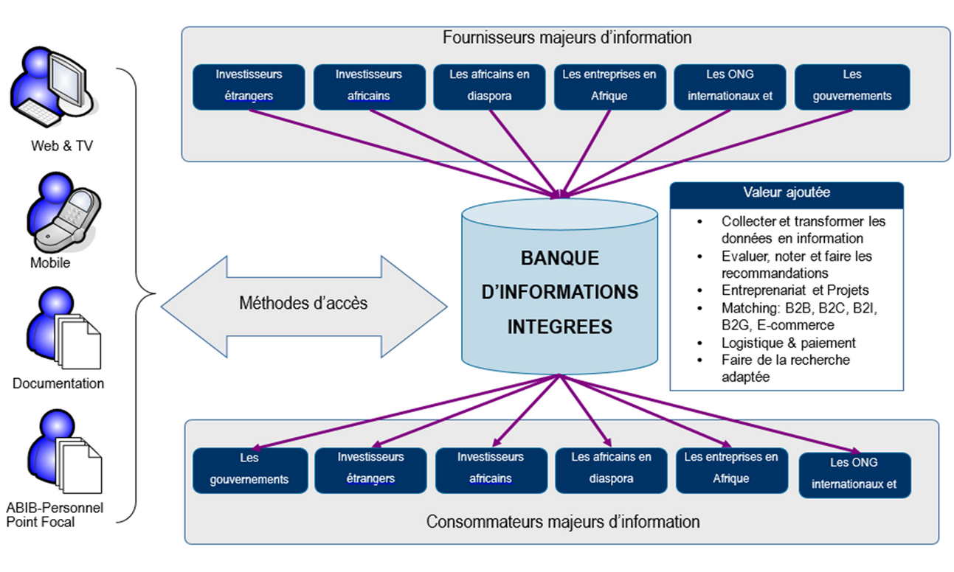
CEEAC integrated Business Information Bank
Already operational platform that processes reliable information and makes it available to economic actors
www.AfricanBIB.biz
The need for the implementation of an INFORMATION BANK
Information is the oil of the 21st century, it must be extracted and processed in order to be able to make money from it
The lack of independent, reliable, accurate, timely and complete information on investment opportunities, companies and African countries;
Notes:
The need for the implementation of an INFORMATION BANK
Already operational platform that processes reliable information and makes it available to economic actors
www.AfricanBIB.biz
Information is the oil of the 21st century, it must be extracted and processed in order to be able to make money from it
The lack of independent, reliable, accurate, timely and complete information on investment opportunities, companies and African countries;
Construire une base de données complète et intégrée qui donne des informations sur l’opérateur et par produit d’intérêt de l’opérateur CEMAC et CEEAC peut être vue comme une mesure d’accompagnement de la réalisation des bénéfices potentiels de la ZLECAf.
Poursuivre l’harmonisation du cadre réglementaire sous - régional en tenant compte des nouveaux services numériques centrés sur les plateformes et les données.
Mettre en place un mécanisme pour garantir que toutes les agences collaborent pour fournir les informations requises, tant au stade initial de la mise en place du portail qu'en tant que responsabilité permanente, pour garantir que le portail est complet et mis à jour.
Établir une base juridique pour les points d'information commerciale et d'entreprise, qui permettra un échange ouvert à la fois pendant la période d'installation initiale et pendant l'exploitation en cours.
Faciliter l'extension à d'autres pays de la plateforme d'information AfricanBIB, une institution basée sur la CEMAC / CEEAC avec plus de 10 ans dans la région, afin de promouvoir rapidement la production, la centralisation et la diffusion d'informations crédibles sur les procédures juridiques et douanières, les organismes de facilitation du commerce, les entreprises, les opportunités d'investissement et les possibilités au sein de la sous-région, tant pour le secteur formel qu'informel.
Faciliter l'extension à d'autres pays de la plateforme d'information AfricanBIB, une institution basée sur la CEMAC / CEEAC avec plus de 10 ans dans la région, afin de promouvoir rapidement la production, la centralisation et la diffusion d'informations crédibles sur les procédures juridiques et douanières, les organismes de facilitation du commerce, les entreprises, les opportunités d'investissement et les possibilités au sein de la sous-région, tant pour le secteur formel qu'informel.

Slide 10
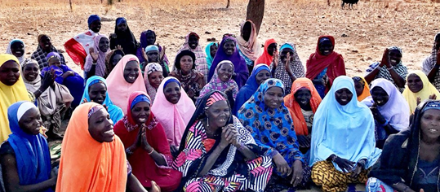

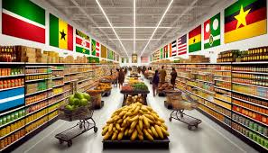
Conclusion
Call to Action:
Develop supportive policies
Building a robust ecosystem 4.0 (Digital/Innovation) for SMEs
Foster collaboration amongst Stakeholder
Invest in infrastructure (including dedicated competitive Zones Clusters/SEZ)
Facilitate Market access
Support the establishment of cooperatives and financing hubs
Adapt innovate and create financing instrument
Consolidate the Financial Institution
Promote entrepreneurship education / Improve financial literacy
Accelerate the implementation of the Information Banking
Develop a strong investment pitch
Build and animate Competive Ecosystem 4.0
Provide
Proximity support services
Consolidate / Groupings (stakeholders)
Adapt / Innovate new financing instrument
Accelerate SMEs
Sensitization / Education of Stakeholder
Notes:
Key Actions for Policymakers:
Building a robust ecosystem for SMEs
Develop supportive policies
Foster collaboration
Invest in infrastructure
Facilitate Market acces
Support the establishment of cooperatives and financing hubs
Adapt innovate and Create financing instrument
Consolidate the Financial Institution

Slide 11
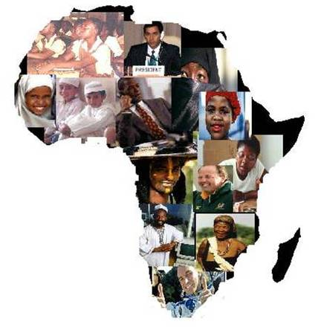

Q&A Session
Thank you for your Attention

